Slide 1


Slide 2

PRESENTED TO:
MUNEEBA IFTIKHAR
CASE STUDY OF SUPER ASIA
PRESENTED BY:
FAIZA IRAM
SARA TARIQ
MS. MASS COMM
(PROFESSIONAL TRACK)

Slide 3

OVERVIEW OF SUPERASIA
ORGANIZATIONAL STRUCTURE
ORGANIZATION ANALYSIS
CHRONOLOGY & DEPARTMENTS
CORPORATE VALUES
MARKET ANALYSIS
COMPETITOR ANALYSIS
MARKET POSITIONING
ADVERTISEMENT STRATEGY
RECOMMENDATION
CONCLUSION
CONTENTS

Slide 4
SUPER ASIA GROUP OVERVIEW
HISTORY
The saga of super Asia started in 1975 by Mr. Mian Muhammad din, the founder of super Asia.
He made his idea a reality by being the first local manufacturer of washing machines in Pakistan.

Slide 5
SUPER ASIA GROUP OVERVIEW
PROFILE
The Group has become synonymous with Quality, Innovation, and Customer Satisfaction.
The brand name “Super Asia” is a well recognized, respected and trusted, not only across Pakistan but in numerous other countries across the globe where its products are being exported.

Slide 6
SUPER ASIA GROUP OVERVIEW
CHRONOLOGY OF EVENTS HAPPENED AT SUPER ASIA IS AS UNDER:
1975: Super Asia produced its first ever Washing Machine in Pakistan.
1981: Introduced Air Cooler in the market.
1985: Offered Geyser in the market.
1995: Introduced Water Dispensers in the marketplace.
2003: Motorcycles launched.
2004: Air conditioner and Microwave Oven offered.
2006: Automotive Parts presented in the market
2008: three-wheeler CNG auto-rickshaw
2010: gas stove and cooker hood

Slide 7
SUPER ASIA GROUP OVERVIEW
DEPARTMENTS OF ORGANIZATION
Super Asia has four major departments which are given below:
Marketing Department
HR Department
Sales Department
Production Department

Slide 8
CORPORATE VALUES
VISION
“To be the market leader in every of our products,
Nationally and regionally”
To establish the character of super Asia with machinery.
By understanding trends in society and obtaining deep insight into issues confronting people in their daily live.

Slide 9
CORPORATE VALUES
MISSION
“To win the utmost satisfaction, trust and loyalty Of our valued customers”
to provide a dynamic, responsive organization that ensures a rapid response to opportunity and competition.
Foremost aim is to provide customers with latest technologies or a business model with high standard quality.

Slide 10
CORPORATE VALUES
SUPER ASIA APPLIANCES OR PODUCTS
Washing Machines
Spinners,
Air Conditioners,
Fans,
Gas And Electric Water Heaters,
Water Dispensers,
Geysers
Electric Water Coolers,
Room Air Coolers,
Evaporative Air Coolers And
Microwave Ovens
Motor Bikes

Slide 11
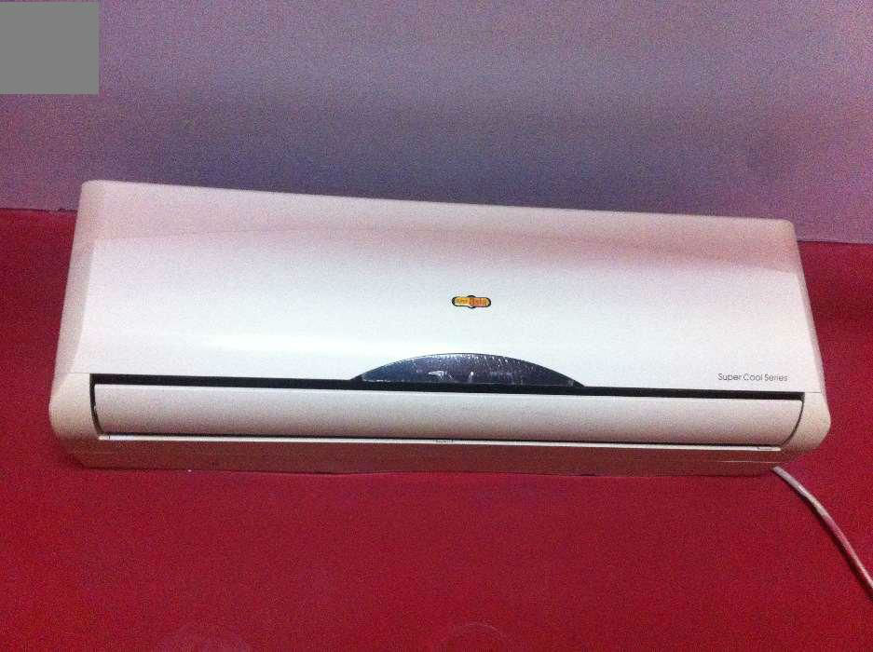
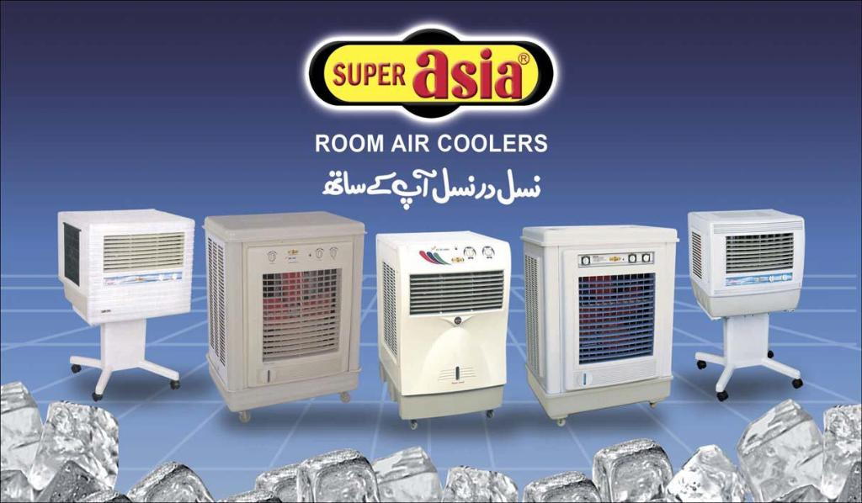
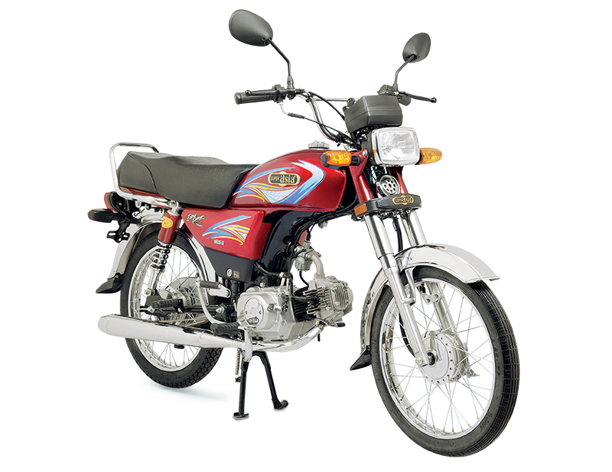
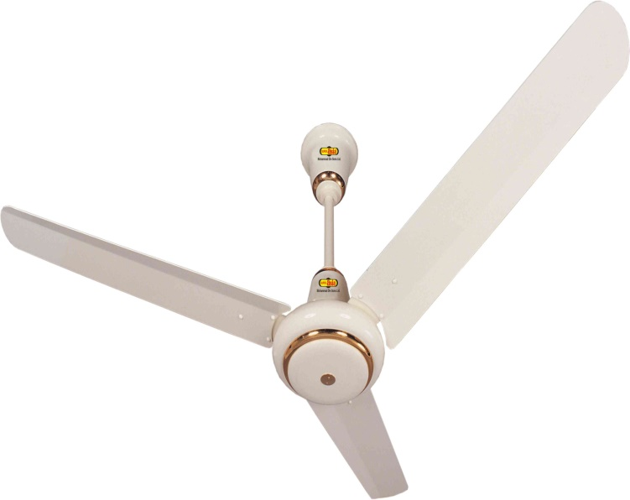

Slide 12
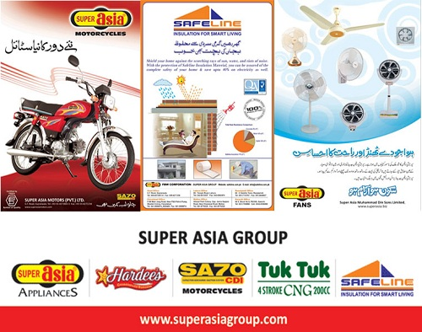
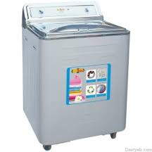
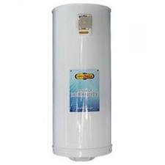

Slide 13
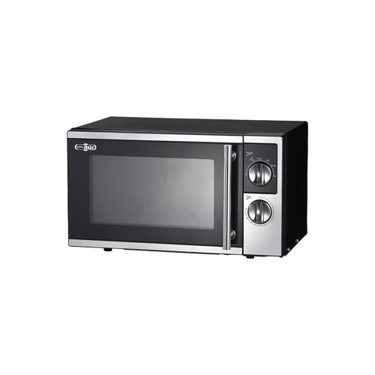
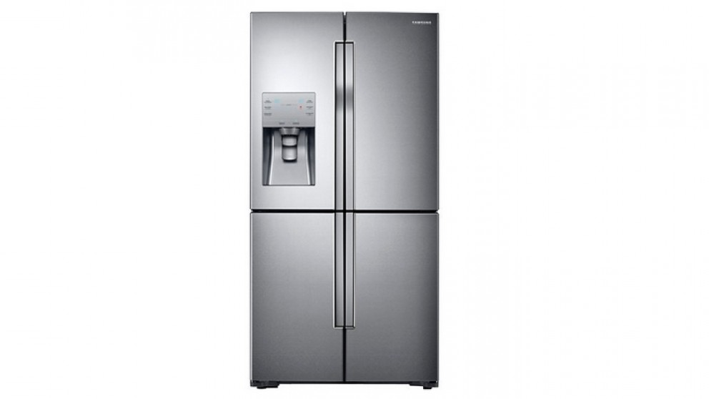
CORPORATE VALUES

Slide 14
ORGANIZATIONAL STRUCTURE
CHAIRMAN
CHIEF EXECUTIVE
DIRECTOR MARKETING
MANAGING DIRECTOR
DIRECTOR PRODUCTION
DIRECTOR FINANCE
DIRECTOR HR
GENERAL MANAGERS

Slide 15
COMMITMENTS
Super Asia group ensure their commitment by
Energy efficiency
Safety
Durability
latest designing
Hassle free warranties
Global dealer network
Product with comfort

Slide 16


Corporate social responsibility
Mian Muhammad din trust hospital
Seed out

Slide 17
ANALYSIS OF ORGANIZATION
SWOT analysis which includes the strengths, weakness, opportunities and threats faced by Super Asia.

Slide 18
ANALYSIS OF ORGANIZATION
SWOT
STRENGTHS:
Products are reliable and according to the customer needs
A large number of models are available
Strong sale channel
Strong advertisement for promoting its products
Market leader in the washing machine sector
Quality products (ISO certified)
Company was built in good faith in the Pakistan market, from a very long time.
The company has the largest market share in all parts of the country in the washing machine industry.
Super Asia is a known brand name to almost every person in the country and very famous in the home appliance industry.

Slide 19
SWOT
WEAKNESSES
High prices
There is a shortage of skilled labor in the company due to which the company has to face big competition.
Advertising budget is a very short in Super Asia relative to other brands in the market.
Not most of the administrative staff is well educated.
Management staffs salaries are very low due to the well-educated and experienced do not come to work in the company.
The management staff do not have direct link with their dealers
Complaints department does not provide appropriate services to customers of the company.
Company has not put appropriate promotional strategies for international markets.
Traders of company complaints for the low profit margin in products.

Slide 20
SWOT
OPPORTUNITIES:
Due to the government's policy of low export duties, Super Asia has opportunities to increase its exports.
Due to the strong financial position of the company, management can use the latest technology in their products.
Company can use the brand name in the international market to increase sales of Fans.
The company is financially very strong, so it can use the electronic media and print to increase their sales.

Slide 21
SWOT
THREATS:
Bigger advertisement budget of others.
Chinese technology is a very big threat to Super Asia.
Other competitors of Super Asia offer the same products at relatively lower prices.
There are a large number of new companies set to increase competition in the market.
HAIER Washing Machine Company invests heavy budget in promoting their products.
Current energy crisis and electricity is a very big obstacle to the company's manufacturing unit. Due to lack of electricity the company may not be able to meet the demand.

Slide 22
MARKET SHARE
BOSTON CONSULTING GROUP MATRIX

Slide 23
MARKET SHARE
STARS
Stars are high growth businesses or products competing in markets where they are relatively strong compared with the competition.
Here the motorcycle and fans of Super Asia best fit because their growth is high but they still need high investment to sustain their growth.

Slide 24
MARKET SHARE
CASH COWS
Cash cows are low-growth businesses or products with a relatively high market share.
Washing Machines of Super Asia comes under this head because they are earning a lot for the company and need very low investment.

Slide 25
MARKET SHARE
QUESTION MARKS
Question marks are businesses or products with low market share but which operate in higher growth markets.
Water Dispensers, Geyser, Room Air Cooler and Safe Lines have very low market share but they operate in higher market growth

Slide 26
MARKET SHARE
DOGS
Unsurprisingly, the term "dogs" refers to businesses or products that have low relative share in unattractive, low-growth markets.
Air Conditioners and Microwave Oven of Super Asia are at this stage.

Slide 27
COMPETITORS ANALYSIS

Slide 28
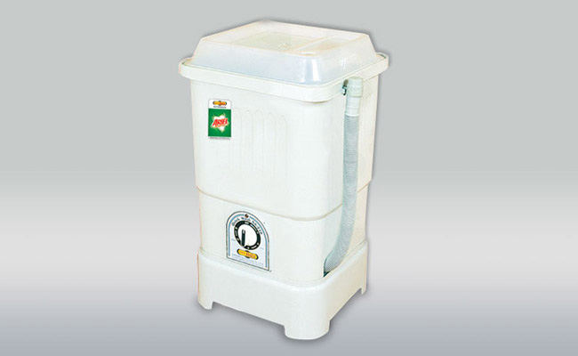
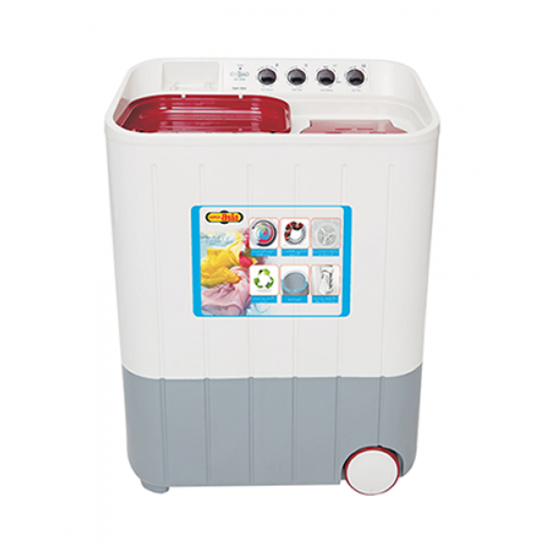
BRAND EQUITY
The brand equity of super asia is washing machine as the industry started with manufacture of washing machine so it is considered as most trustable product which have created an optimistic image of super asia in the market.

Slide 29
MARKET SHARE

Slide 30
MARKET ANALYSIS
GEOGRAPHIC SEGMENTATION
Decide to analyze whole world market
Then focus on Pakistan market
On base of gender.
For every product there is different segment
PSYCHOGRAPHIC SEGMENTATION
lifestyle
Family status
BEHAVIORAL SEGMENTATION
DEMOGRAPHIC SEGMENTATION

Slide 31
MARKET ANALYSIS
PRODUCT LIFE CYCLE
DEVELOPMENT STAGE
GROWTH STAGE
MATURITY STAGE
INTRODUCTION STAGE

Slide 32
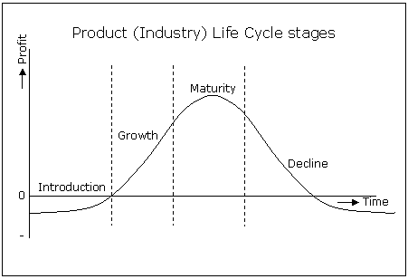
MARKET ANALYSIS
PRODUCT LIFE CYCLE

Slide 33
MARKETING MIX
PRODUCT
Variety
PRICE
List Price
Advertising
PLACE
Channels
PROMOTION
Quality
Design
Features
Brand Name
Packaging
Services
Discounts
Allowances
Payment Period
Credit Terms
Coverage
Assortments
Locations
Inventory
Transportation
Personal Selling
Sales Promotion
Public Relation

Slide 34
MARKETING POSITIONING
PRICING
QUALITY
SERVICE
DISTRIBUTION
PACKAGING

Slide 35
ADVERTISEMENT STRATEGY
AD’S
EVENTS SPONSORED
INTERNATIONAL CHANNELS

Slide 36
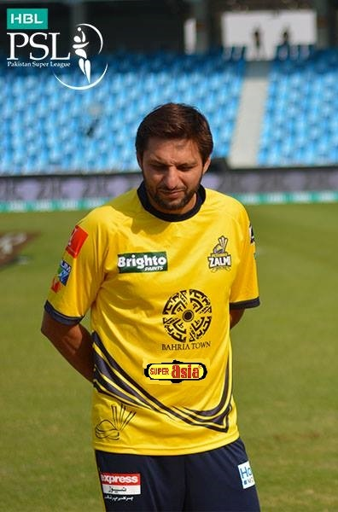


ADVERTISEMENT STRATEGY

Slide 37
RECOMMENDATIONS
Super Asia is also offering motorcycle with its brand name but there are lot of complaints the company is facing from its motorcycle department. So the organization must improve the quality of its motorcycle in order to maintain its goodwill.
The organization is also in process of computerizing its records which is good sign but it is going on with small progress. Computerization must be done on early basis .
Company’s different schemes must be conveyed to the targeted customers so that to increase the share in market.
Super asia should also work on its advertisements to make them more attractive than its competitors.

Slide 38
CONCLUSION
Super asia is most probably the first and oldest machinery industry which have been progressing in the field much better. But they need more efforts in their advertisement department and should spend more budgets so that they can enhance their marketing value as comparison with their competitors.

Slide 39


